Slide 1


brainSTORM
brainSTORM
Notes:
Hello! So my proposed event is called brainSTORM.

Slide 2
1
basis
Notes:
And the basis of the idea is

Slide 3
an event that takes community-identified problems and asks designers to brainstorm ideas in order to familiarize them with the conceptualization process of design
Notes:
an event that takes community-identified problems and asks designers to brainstorm ideas in order to habituate them with the conceptualization process of design

Slide 4
2
formulation
Notes:
And how I came up with this idea was

Slide 5
past events of DesignCo
“listen”
“workshop”
“follow”
Notes:
I’m a fairly new member of DesignCo, so I used DesignCo’s event page to see the trend and gauge on-brand events that are typically hosted. All the events that I’ve attended were info sessions and workshops, which makes a lot of sense because you want to cater to all members of your organization, and those basics needed to be covered, for new designers especially, in order to move onto more actionable and hands-on events later on. And I think you guys did a really nice and thorough job in those :D

Slide 6
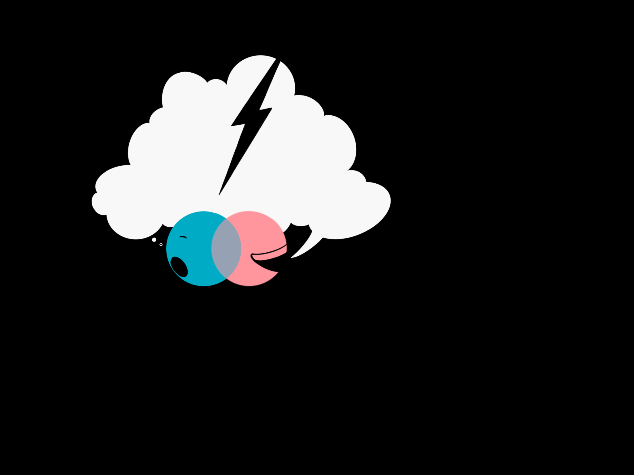
interactive
interactive
“discuss”
“engage”
experiential
“solve”
experiential
Notes:
But after all of these workshops, I wanted to plan something that slowly eases designers into more experiential and interactive events. This was a little hard because most people would prefer to block out their own time to work on their portfolio, and I didn’t want to encroach on their time for passion projects, but I also thought it would be much more helpful to have them actually play around with either data or programs that had to do with design. I also noticed that many past events were dedicated to technical skills, so I wanted to give our members a chance to learn how to engage with their own ideas, and how to engage with community ideas, since those are the people we’re designing for.

Slide 7
3
marketing + execution

Slide 8

social media teaser
Notes:
DesignCo typically promotes their events with a post about 5-8 days before the event, but I wanted to give a really simple little teaser about 10 days before on the account’s story.

Slide 9
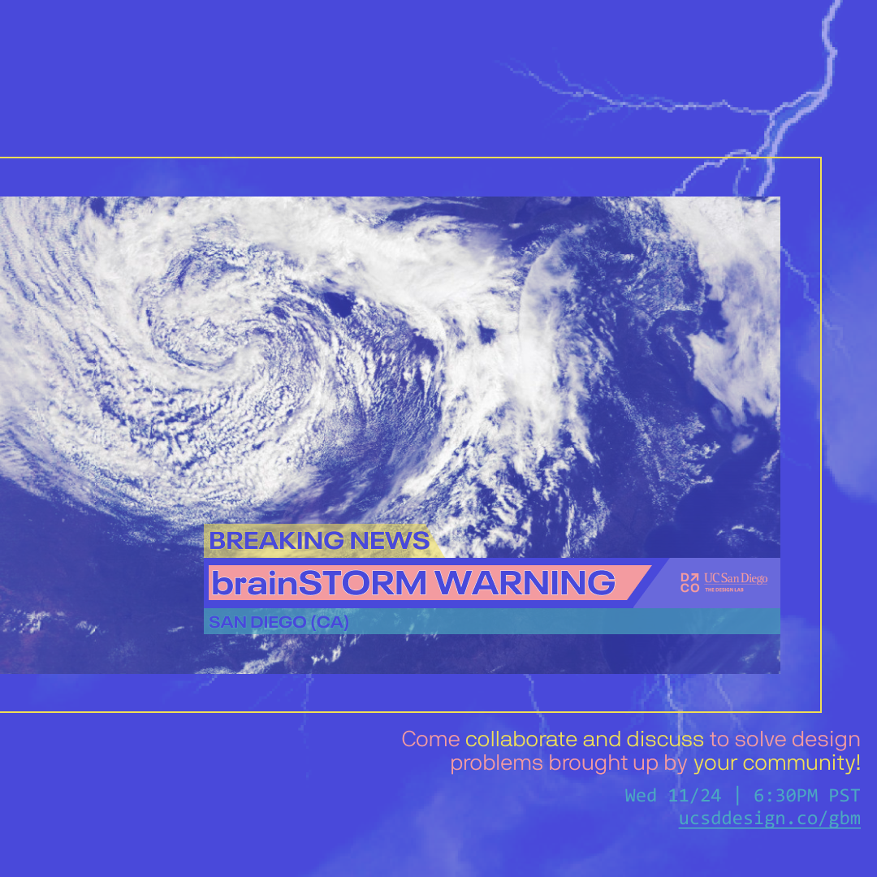
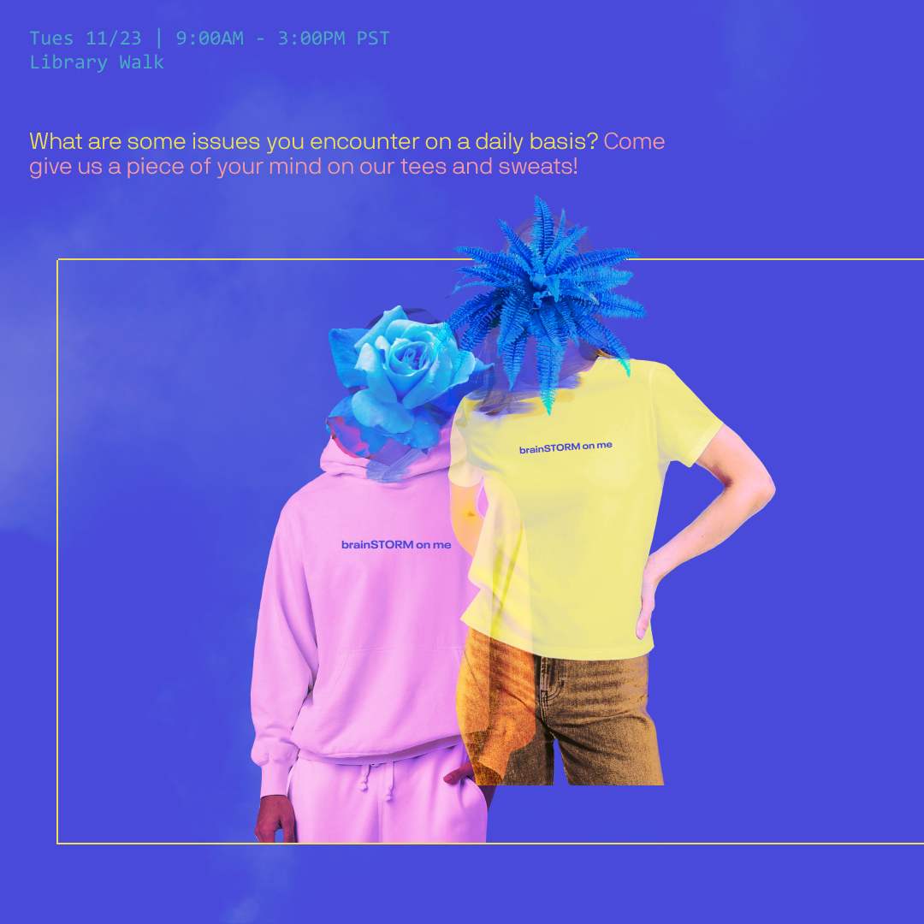
social media promotion
Notes:
Then, I would put out this post 6 days before, so if the event were hypothetically happening on Wednesday, November 24, I would post on the 18th at around 4PM because that’s a pretty optimal time for activity. I really liked that DesignCo puts themes on their events, so I kind of oriented my approach like that too. I incorporated a lot of DesignCo’s branding trends, like the blend mode graphics and use of texture and line, while also trying to maintain my own subtle style as a designer.

Slide 10
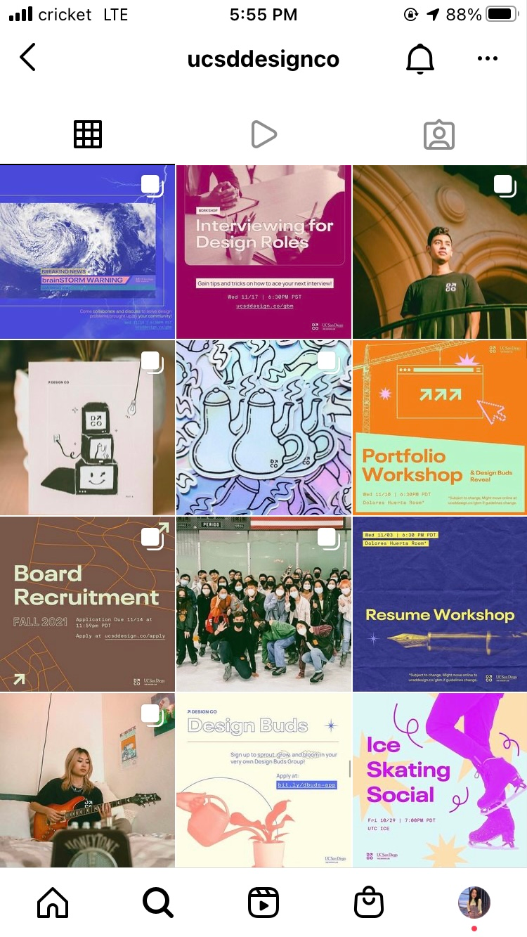
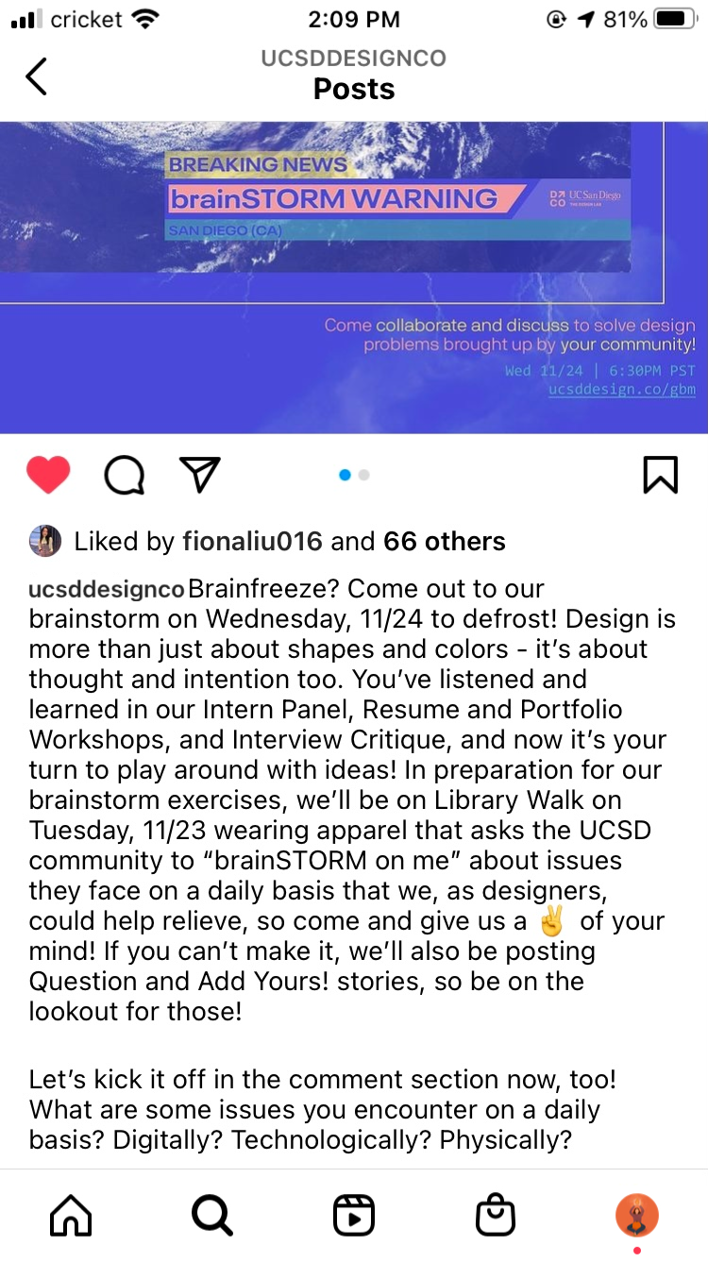
social media promotion
Notes:
And here it is on the feed. The caption just says:
Brainfreeze? Come out to our brainstorm on Wednesday, 11/24 to defrost! Design is more than just about shapes and colors - it’s about thought and intention too. You’ve listened and learned in our Intern Panel, Resume and Portfolio Workshops, and Interview Critique, and now it’s your turn to play around with ideas! In preparation for our brainstorm exercises, we’ll be on Library Walk on Tuesday, 11/23 wearing apparel that asks the UCSD community to “brainSTORM on me” about issues they face on a daily basis that we, as designers, could help relieve, so come and give us a ✌️ of your mind! If you can’t make it, we’ll also be posting Question and Add Yours! stories, so be on the lookout for those!
Let’s kick it off in the comment section now, too! What are some issues you encounter on a daily basis? Digitally? Technologically? Physically?

Slide 11



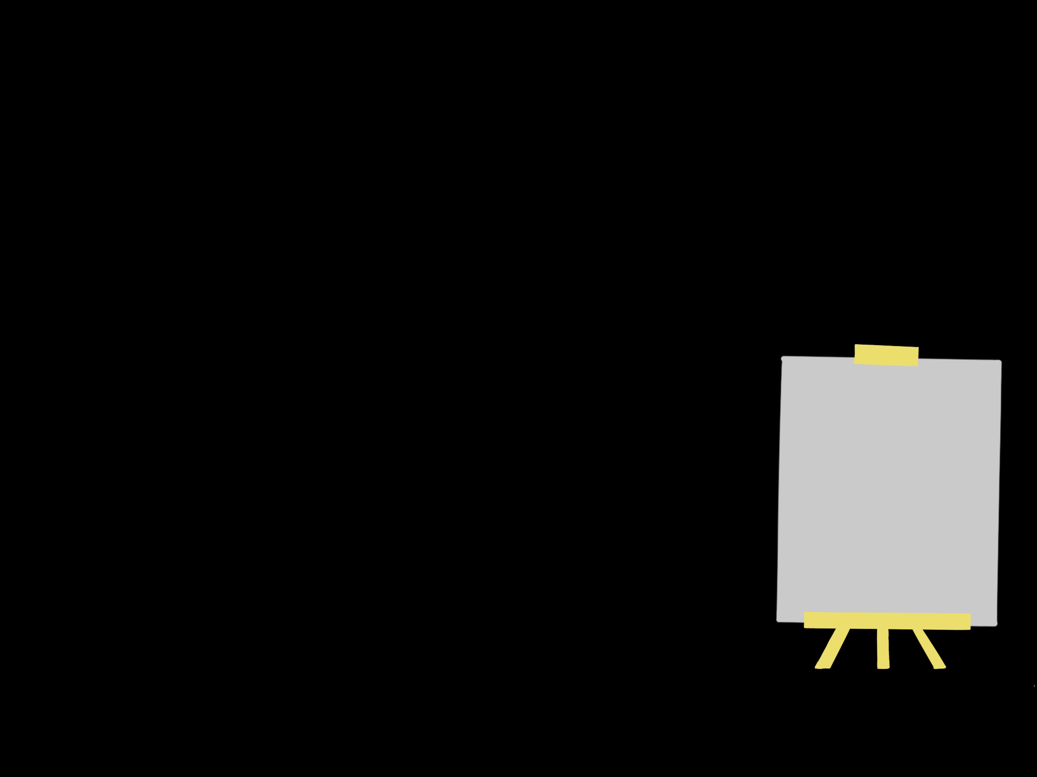
physical data collection
brainSTORM on me
brainSTORM on me
brainSTORM on me
what are some issues you encounter on a daily basis?
digitally? technologically?
physically?
Notes:
As forementioned, in preparation for this exercise, we’d have to gather communal data. And my process for gathering this will simultaneously act as our advertising too, so a little more on this idea of a t-shirt brainstorm. I sparked this idea of promotional t-shirts in my application and I wanted to actually delve a little more into it with this challenge, so I was thinking of having members stand on a well-passed area like Library Walk wearing “brainSTORM on me” tees or sweats. Students and other passerbys have the opportunity to physically write on the tees in response to a prompt like, “What are some issues you encounter on a daily basis?” We can definitely vary the specificity of prompts later on, but currently, this is the general prompt I had, heh.

Slide 12
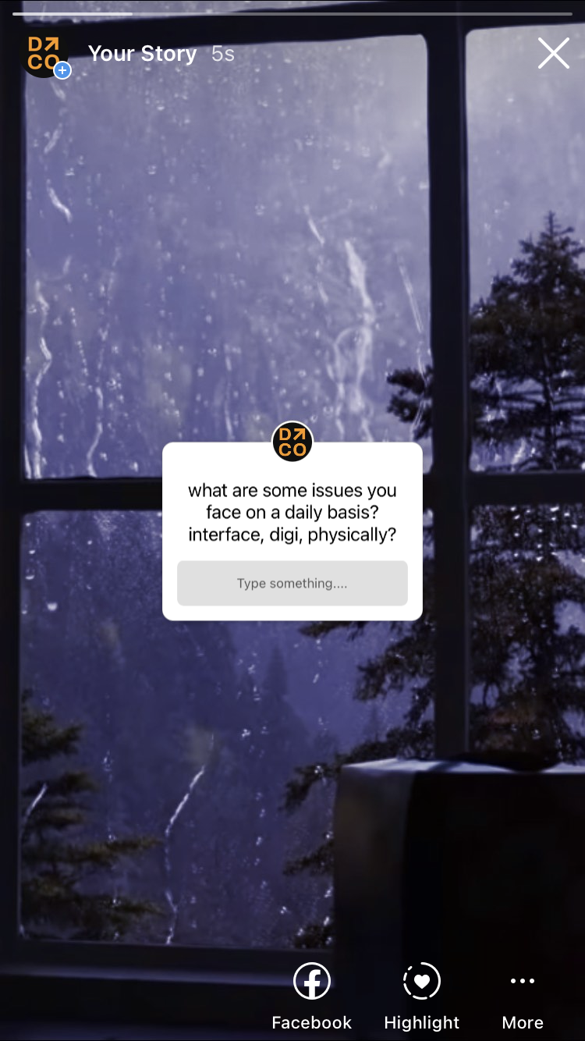
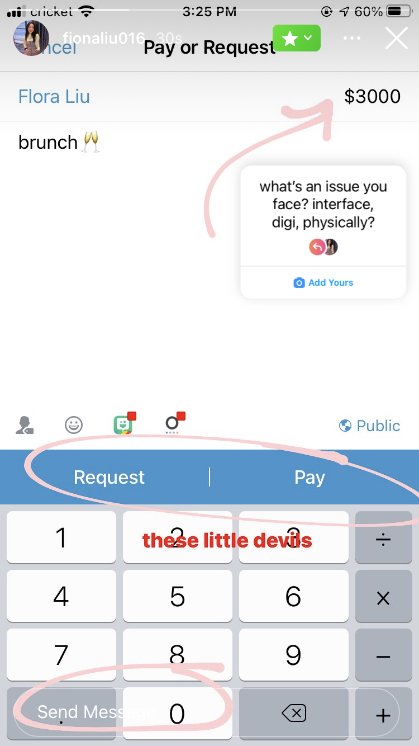
social media data collection
Notes:
And of course, we’d also need to extend that into social media, too. Here, I’ve just set up some stories followers can engage with leading up to the event that can also serve as data.

Slide 13
4
reflection

Slide 14
challenges
scale
misinformation
accessibility
Notes:
So in coming up with this event idea, I was a little uneasy about a few things.
Scale: I wasn’t really sure if event was a GBM or like an actual event like Stride, so I worry I may have misunderstood the assignment. But scale also considered time-commitment on the board’s end, whether the promotional to executional ratio balances out, if people would even find this helpful.
Misinformtaion: This was a smaller one on my end, but I was trying to be careful that my emergency warning and storm warning advertisements wouldn’t be TOO realistic, because that could actually pose a misinformation and danger threat. So I had to kind of draw that fine line between design and realism.
Accessibility: This one was hard too because often, it’s difficult to ask users to come up and identify problems with their own lives because they’re so accustomed to it. So I questioned whether this was a good idea, but I think it’ll be okay because it would give our designers experience nonetheless; bad data can still be a testament to experience. It’ll give our prospective UX researchers experience in sorting through and categorizing a lot of data that might not always be stellar! It’ll also demonstrate how broad design issues plague our lives - from product design to interface design!

Slide 15
runner ups
Designathon: Battle of the Bands
group case study on differences in user experience on various
music streaming platforms
Website Workshop
delve into portfolio building methods:
basic HTML, wix.com, squarespace.com

Slide 16
THANK YOU!

